Slide 1
Multimedia System and Virtual Environment
CSE – 310
Lecture 1
Introduction
Dept. of Computer Science and Engineering, University of Rajshahi

Slide 2
Introduction
Lecture 1
What is multimedia?
Components of Multimedia.
What is multimedia system?
Where to use multimedia.
Dept. of Computer Science and Engineering, University of Rajshahi

Slide 3
Introduction
Lecture 1
What is Multimedia?
Multimedia is a combination of text, graphics, images, video, and audio to enrich its content and enhance communication.
Examples
Websites with video or animation
PowerPoint presentations
CD-ROM projects
Web pages with QuickTime/Real Video movies
Dept. of Computer Science and Engineering, University of Rajshahi

Slide 4
Introduction
Lecture 1
Components of Multimedia
Multimedia involves multiple modalities of
text
audio
images
drawings
animation
video
Dept. of Computer Science and Engineering, University of Rajshahi

Slide 5
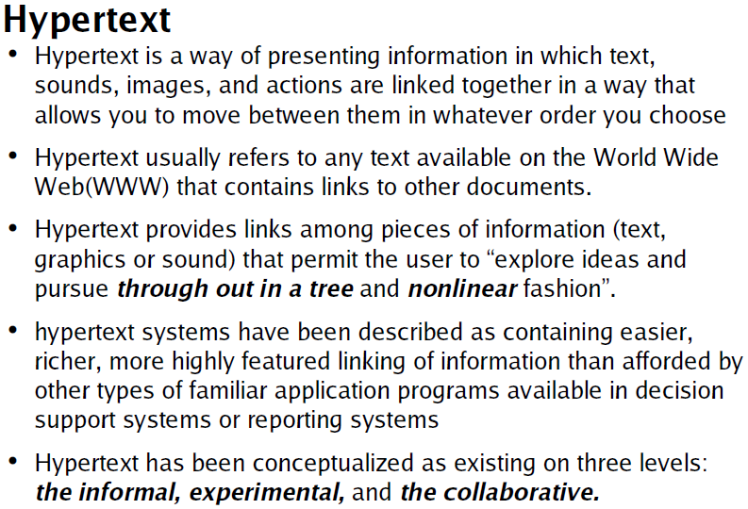
Introduction
Lecture 1
Dept. of Computer Science and Engineering, University of Rajshahi

Slide 6
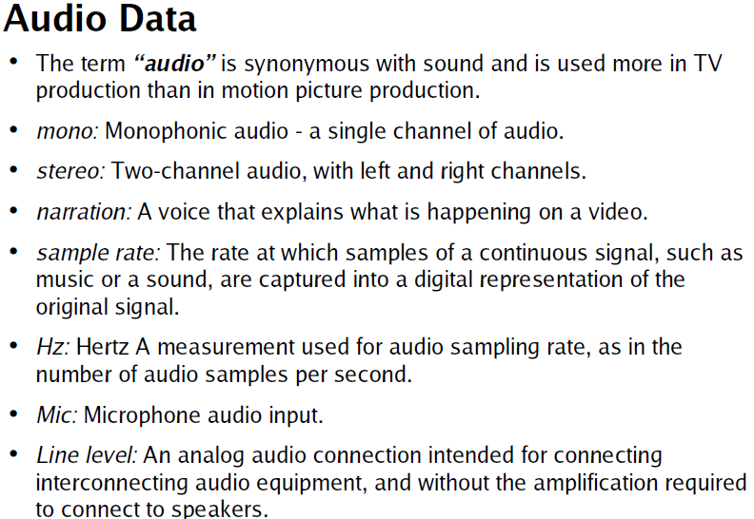
Introduction
Lecture 1
Dept. of Computer Science and Engineering, University of Rajshahi

Slide 7
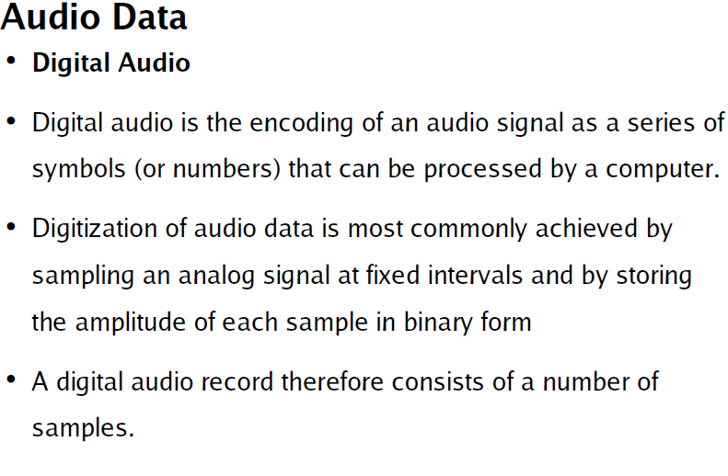
Introduction
Lecture 1
Dept. of Computer Science and Engineering, University of Rajshahi

Slide 8
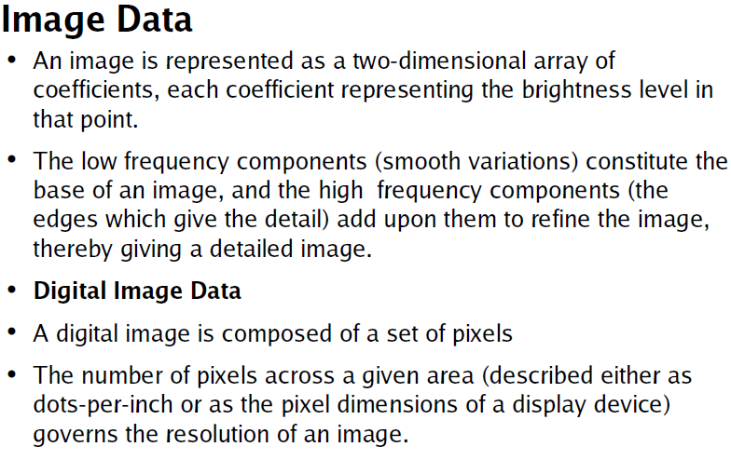
Introduction
Lecture 1
Dept. of Computer Science and Engineering, University of Rajshahi

Slide 9
Introduction
Lecture 1
Animation
Animation is the rapid display of a sequence of images of 2-D or 3-D artwork or model positions in order to create an illusion of movement.
The effect is an optical illusion of motion due to the phenomenon of persistence of vision.
The most common method of presenting animation is as a motion picture or video program.
Dept. of Computer Science and Engineering, University of Rajshahi

Slide 10
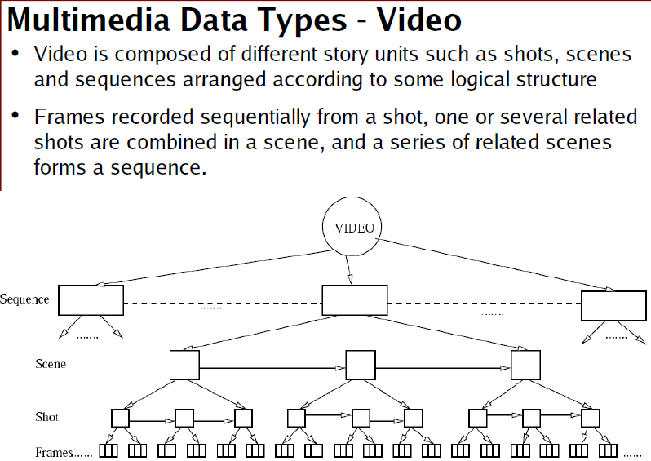
Introduction
Lecture 1
Dept. of Computer Science and Engineering, University of Rajshahi

Slide 11
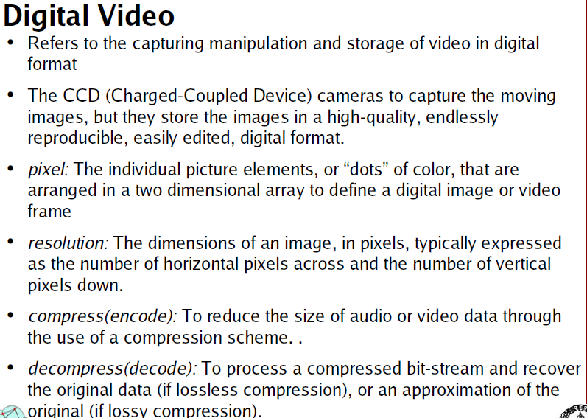
Introduction
Lecture 1
Dept. of Computer Science and Engineering, University of Rajshahi

Slide 12
Introduction
Lecture 1
Multimedia Information Representation
All media types are stored and processed in digital form
text, graphics, images (discrete, measured in units like bits)
audio, video (continuous, measured in bits per sec)
analog signals which must be converted into digital form
Dept. of Computer Science and Engineering, University of Rajshahi

Slide 13
Introduction
Lecture 1
What is a Multimedia System?
A system that involves:
generation
representation
storage
transmission
search and retrieval
delivery
of multimedia information
production/authoring tools
compression and formats
file system design
networking issues
database management
server design, streaming
Dept. of Computer Science and Engineering, University of Rajshahi

Slide 14
Introduction
Lecture 1
Application Areas
Residential Services
video-on-demand
video phone/conferencing systems
multimedia home shopping (MM catalogs, product demos and presentation)
self-paced education
Business Services
Corporate training
Desktop MM conferencing, MM e-mail
Dept. of Computer Science and Engineering, University of Rajshahi

Slide 15
Introduction
Lecture 1
Application Areas (cont.)
Education
Distance education - MM repository of class videos
Access to digital MM libraries over high speed networks
Science and Technology
computational visualization and prototyping
astronomy, environmental science
Medicine
Diagnosis and treatment - e.g. MM databases that provide support for queries on scanned images, X-rays, assessments, response etc.
Dept. of Computer Science and Engineering, University of Rajshahi

